Slide 1
Assembly
2025-02-26

Slide 2

“Hey can you do this for me…?”
I just sequenced a genome. Can you look at it for me?
How big is the genome?
How many genes are in my genome?
Does it look good?

Slide 3

Outline
Sequencing
prediction
annotation
Display
Assembly
Hands on QC of Illumina data
Genome assembly with Illumina
Genome assembly QC

Slide 4
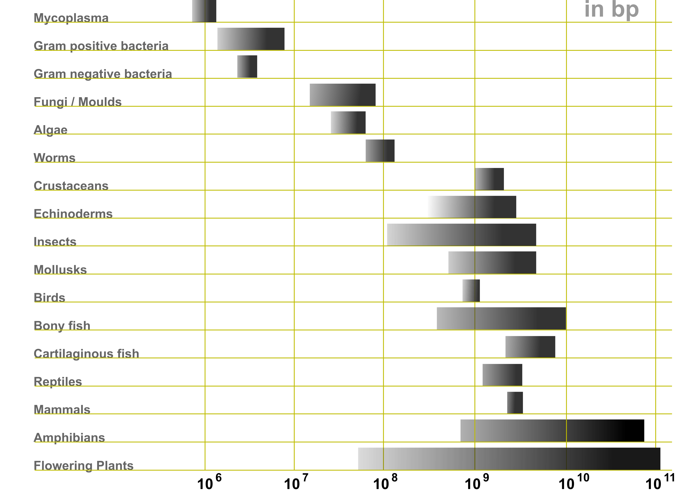
https://en.wikipedia.org/wiki/Genome_size
Notes:
Scale is logarithmic

Slide 5
A few different kinds of raw reads
1st gen: ~1k, accurate, few
2nd gen
Short, accurate, usually 20-100x (Illumina)
Longer, homopolymer errors, usually 20-50x (454 and Ion Torrent)
3rd gen: Long, indel errors, many
Notes:
Just a reminder of what we went over last week

Slide 6

Getting data
From NCBI
Other sources outside of scope
From your lab
From another website

Slide 7
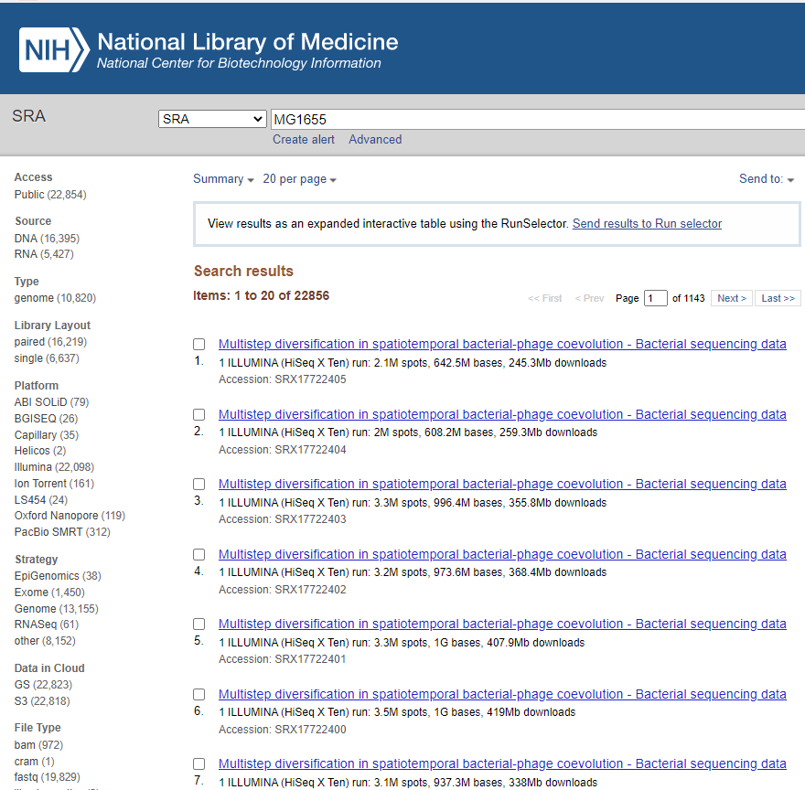
Data from NCBI/SRA
Need the SRA run accession
Search SRA:
https://ncbi.nlm.nih.gov/sra/?term=MG1655
https://hpc.nih.gov/apps/sratoolkit.html
https://github.com/ncbi/sra-tools/wiki/HowTo:-fasterq-dump
Notes:
https://hpc.nih.gov/apps/sratoolkit.html
https://github.com/ncbi/sra-tools/wiki/HowTo:-fasterq-dump

Slide 8
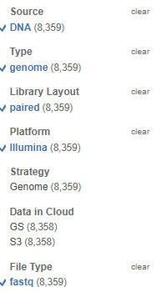
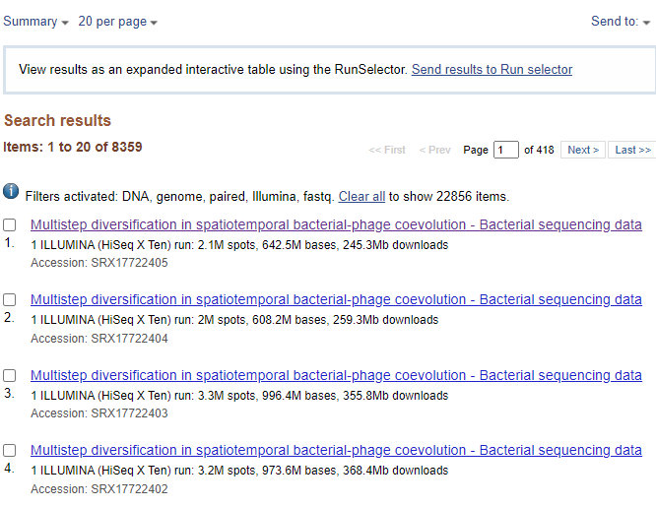
Filter it down

Slide 9
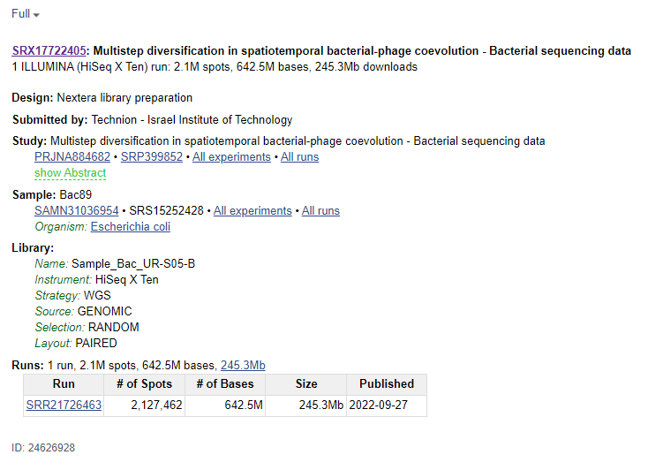
Find the accession
At the bottom
Starts with SRR, ERR, or DRR
In this case, SRR21726463

Slide 10
Install SRA Toolkit
$ mkdir -pv ~/bin
$ cd ~/bin
$ wget https://ftp-trace.ncbi.nlm.nih.gov/sra/sdk/3.0.7/sratoolkit.3.0.7-ubuntu64.tar.gz
$ tar zxvf sratoolkit.3.0.7-ubuntu64.tar.gz
$ export PATH=$PATH:~/bin/sratoolkit.3.0.7-ubuntu64/bin
Installation instructions at https://github.com/ncbi/sra-tools/wiki/01.-Downloading-SRA-Toolkit
The export PATH command will need to be run each time you log in. It tells Linux that this is a directory, where it can find executable files.

Slide 11
Download the SRA run accession for Illumina
$ mkdir -pv ~/fundamentals/assembly/reads
$ mkdir -pv ~/fundamentals/assembly/asm
$ cd ~/fundamentals/assembly
$ SRR=SRR21726463
$ prefetch $SRR
$ fasterq-dump $SRR --threads 1 --outdir reads/$SRR --split-files --skip-technical
$ gzip -v reads/$SRR/*.fastq
Create a set of directories under “assembly” which are “reads” and “asm” for raw reads and assemblies
Go into the directory with ‘cd’
Set the SRR variable
prefetch: download the file so that it can be converted to fastq later. Optional.
Run fasterq-dump to download/format $SRR
gzip: compress the fastq files into fastq.gz format
Notes:
make a directory for today’s lesson
Make a subfolder reads, asm
download the SRA run accession into reads/
Go ahead and download other chemistries too

Slide 12
Preliminary QC
QC: Quality Control

Slide 13
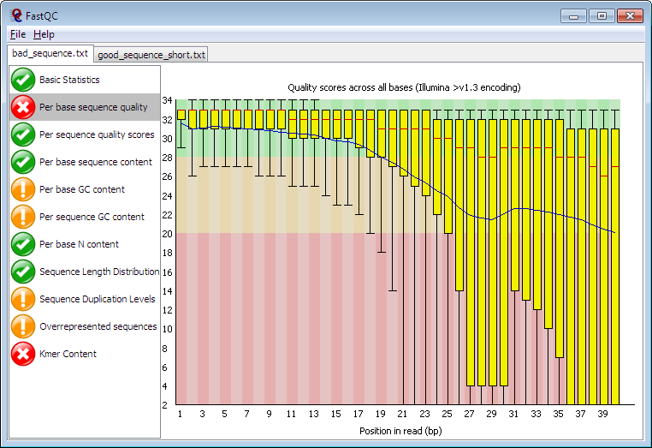
We need fastqc
Use Conda to install
Question: What are the command(s) to install fastqc?
Hint: package name is fastqc
Answer:
mamba create -n fastqc fastqc
conda activate fastqc
Notes:
https://www.bioinformatics.babraham.ac.uk/projects/fastqc/

Slide 14
Basic QC
$ conda activate fastqc
$ ls reads/$SRR/*.fastq.gz
SRR21726463_1.fastq.gz SRR21726463_2.fastq.gz
$ fastqc reads/$SRR/*.fastq.gz
$ ls reads/$SRR
SRR21726463_1.fastq.gz SRR21726463_1_fastqc.zip SRR21726463_2_fastqc.html
SRR21726463_1_fastqc.html SRR21726463_2.fastq.gz SRR21726463_2_fastqc.zip
$ firefox reads/$SRR/*.html
Notes:
Run fastqc; files are generated

Slide 15
Illumina assembly

Slide 16
The problem at hand
Average microbial genome is 2,000,000bp (2Mb)
about 1Mb, up to 10Mb usually.
Reads not as long as a genome
Illumina reads -> 150bp or 250bp
Need to put the reads together like a puzzle
https://linsalrob.github.io/ComputationalGenomicsManual/SequenceAssembly/
Notes:
https://linsalrob.github.io/ComputationalGenomicsManual/SequenceAssembly/

Slide 17
Two main assemblers
Both are based on de Bruijn graph algorithm
SPAdes
Values longer contigs
Risk of misassembly
Stochastic
SKESA
Values accurate base calls
Shorter contigs
Deterministic

Slide 18
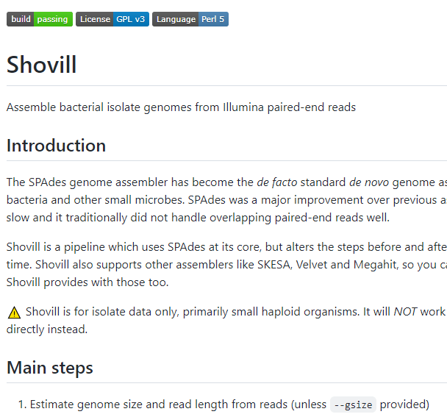
⚡♠️ Shovill
https://github.com/tseemann/shovill
An assembly pipeline
Prepares reads
Assembly
Assembly correction
Notes:
is a play on the words 'Spades' and 'Illumina’
pronounced as 'shovel' in English

Slide 19
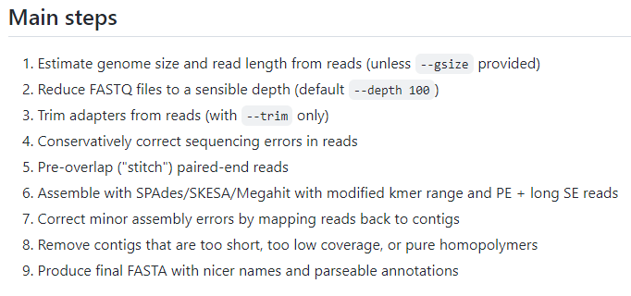
⚡♠️ Shovill
Notes:
1. Estimate genome size: needed to reduce the reads to 100x
2. reduce coverage to 100x: this helps the genome assembler to not get confused
3. trim adapters: some read healing to get rid of artificial sequence
4. correct sequencing errors in reads: read healing
5. stitch paired-end reads together: create long single end reads from pairs when they overlap
6. assembly: make consensus sequences in contigs
7. correct minor assembly errors: polishing
8. remove contigs that are too short: removes probable contamination or artifacts
9. produce final fasta: final assembly

Slide 20
Running vanilla spades or skesa
$ conda deactivate
$ conda create shovill -n shovill
$ conda activate shovill
$ R1=reads/$SRR/${SRR}_1.fastq.gz
$ R2=reads/$SRR/${SRR}_2.fastq.gz
$ spades.py -1 $R1 -2 $R2 -o asm/$SRR.spades
$ skesa --reads $R1 $R2 --use_paired_ends --contigs_out asm/$SRR.skesa
Notes:
Run fastqc; files are generated

Slide 21
Running shovill
$ shovill --help
$ shovill --outdir asm/$SRR.shovill --assembler spades --R1 $R1 --R2 $R2

Slide 22
Assembly QC

Slide 23
Assembly Metrics How do you tell if your assembly is good?
Metric | description
Assembly Length | The size of the concatenated assembly
Number of Contigs | The count of contigs
Longest Contig
Average contig length
GC-content | Percentage of the genome that is either G or C
N50 | The size of the contig at where half the genome is located in size >N50 and half is located in size <N50

Slide 24
Looking at N50 in a different way
90k 80k 70k 60k 50k 40k 10k 10k
sort the contigs by size
An example genome size (in kb): 90 + 80 + 70 + 60 + 50 +40 +10 +10 = 410
Half the genome size is 205kb
90+80+70 = 240k.
The contig that gets us to that size is 70k.
N90: 90% of the genome is contained
90% of 410 = 369
90 + 80 + 70 + 60 +50 + 40 = 390
N90 = 40k
⬅Sorted contig sizes in assembly ➡

Slide 25
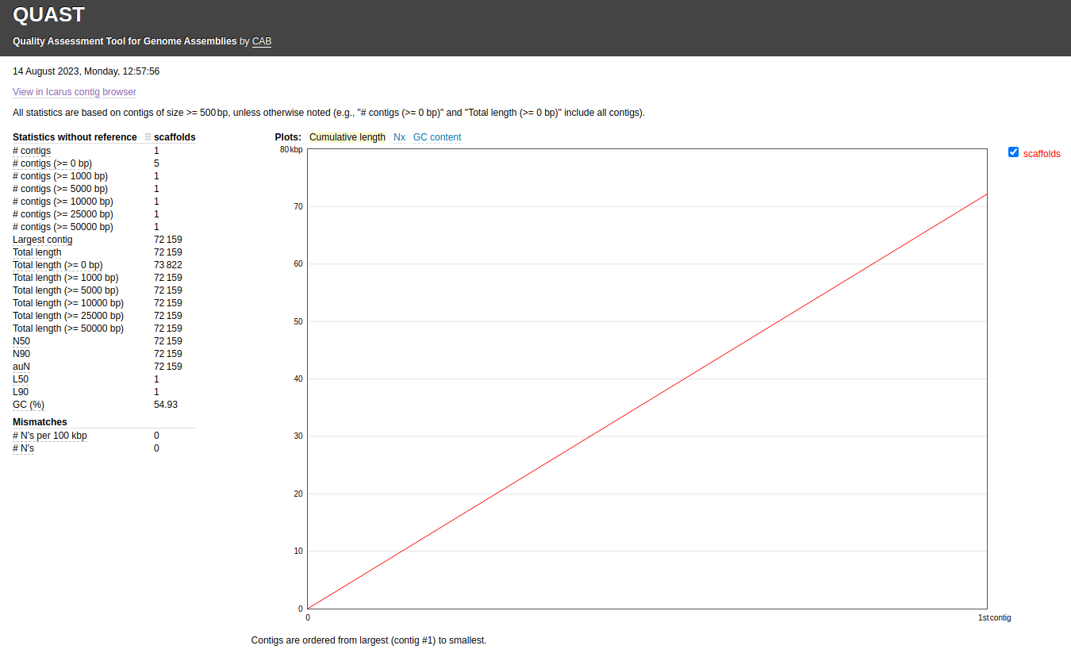
Quast
Gives metrics on assemblies
Can install with `conda create -n quast quast`
QUAST output contains things like
report.tsv - tab-separated version of the summary, suitable for spreadsheets (Google Docs, Excel, etc)
report.html - HTML version of the report with interactive plots inside
Credit to Taylor Paisie
https://taylorpaisie.github.io/VEME_2023_NGS_Denovo_assembly/#use-quast-to-analyze-the-spades-output-scaffolds-fasta-file

Slide 26
Assembly comparison

Slide 27
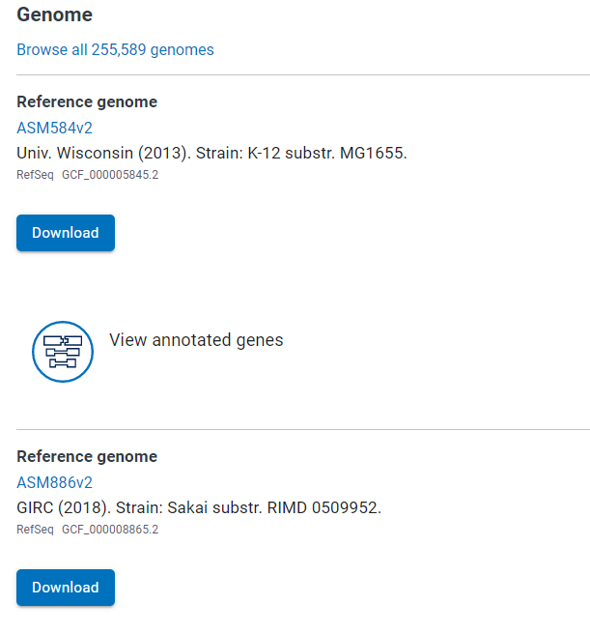
Let’s get the two E. coli reference genomes
https://www.ncbi.nlm.nih.gov/datasets/taxonomy/562/
Notes:
also see that we have accessions starting with GCF

Slide 28
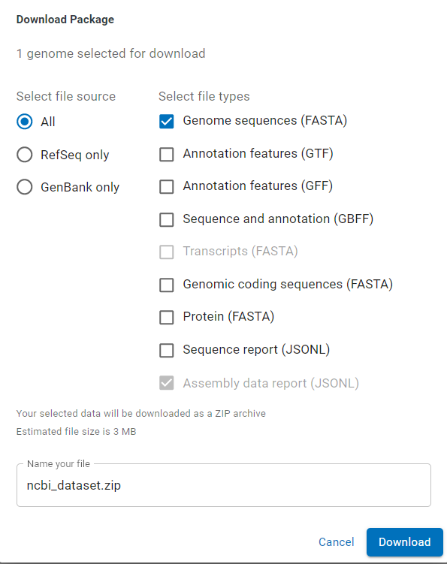
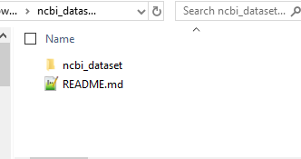
For each of the two genomes…

Slide 29
Or, on the command line
$ mkdir -pv ~/fundamentals/assembly/asm
$ cd ~/fundamentals/assembly/asm
$ mamba create -n ncbi-datasets ncbi-datasets-cli zip unzip mauve
$ conda activate ncbi-datasets

Slide 30
Or, on the command line
$ datasets download genome accession GCF_000005845.2 GCF_000008865.2
$ unzip ncbi_dataset.zip
Archive: ncbi_dataset.zip
inflating: README.md
inflating: ncbi_dataset/data/assembly_data_report.jsonl
inflating: ncbi_dataset/data/GCF_000005845.2/GCF_000005845.2_ASM584v2_genomic.fna
inflating: ncbi_dataset/data/GCF_000008865.2/GCF_000008865.2_ASM886v2_genomic.fna
inflating: ncbi_dataset/data/dataset_catalog.json

Slide 31

Comparison with Mauve
https://darlinglab.org/mauve/mauve.html

Slide 32
Run Mauve on the two genomes
$ progressiveMauve ./ncbi_dataset/data/GCF_000008865.2/GCF_000008865.2_ASM886v2_genomic.fna ./ncbi_dataset/data/GCF_000005845.2/GCF_000005845.2_ASM584v2_genomic.fna --output comparison.xmfa
Storing raw sequence at /tmp/rawseq837311.000
Sequence loaded successfully.
./ncbi_dataset/data/GCF_000008865.2/GCF_000008865.2_ASM886v2_genomic.fna 5594605 base pairs.
Storing raw sequence at /tmp/rawseq837311.001
Sequence loaded successfully.
./ncbi_dataset/data/GCF_000005845.2/GCF_000005845.2_ASM584v2_genomic.fna 4641652 base pairs.
Using weight 15 mers for initial seeds
Creating sorted mer list
Create time was: 2 seconds.
Creating sorted mer list

Slide 33
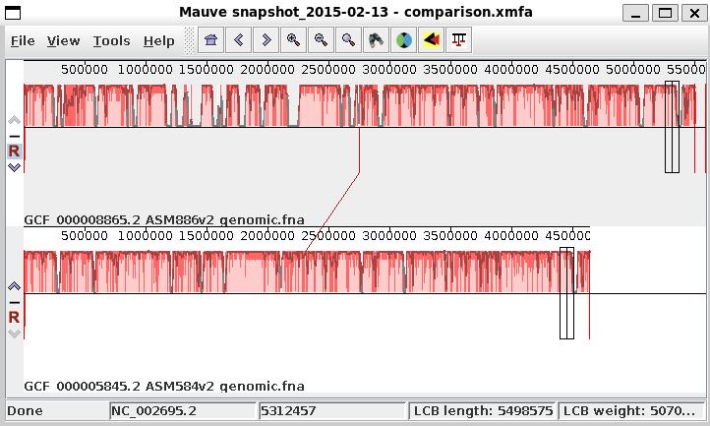
Mauve viz
$ Mauve comparison.xmfa

Slide 34
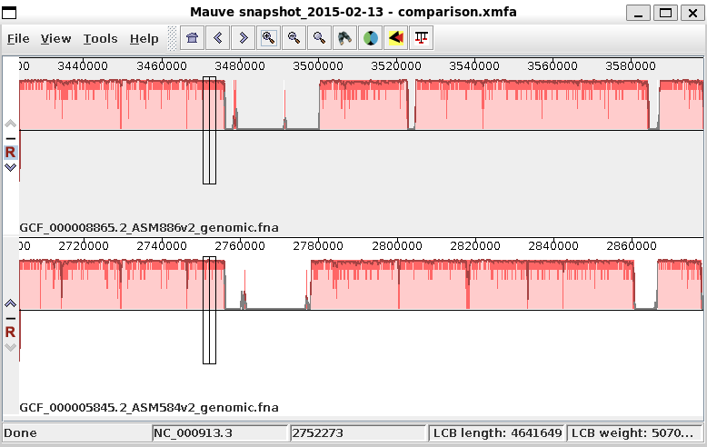
Zoom in a little with Mauve
Notes:
Local Colinear Blocks
Histograms of similarity
Coordinates

Slide 35
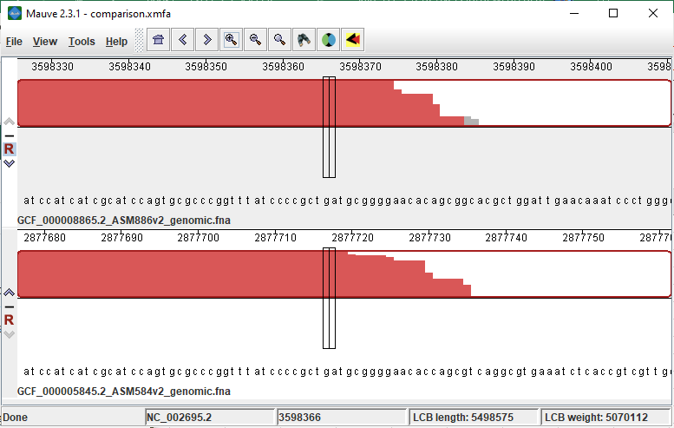
Nucleotide level zoom

Slide 36
Done!
Sequencing
prediction
annotation
Display
Assembly
We learned
Genome assembly
Assembly comparison

